Slide 1
MSc Software Development
CSC7061 - Programming
Compound assignment operators

Slide 2

Compound Assignment operators
The compound assignment operators abbreviate assignment expressions.
variable = variable operator variable;
where operator is one of the binary operators +, -, *, / or %
Why? Compound assignment operators can make your code more concise and readable...
Operator | example | explanation | assigns
+= | num += 4; | num=num+4; | num to 10
-= | num -=2; | num=num-2; | num to 4
*= | num*=3; | num=num*3 | num to 18
/= | num/=2; | num=num/2; | num to 3
%= | num%=5; | num=num%5; | num to 1
initially num = 6
(for each example)
Notes:
Software Development

Slide 3

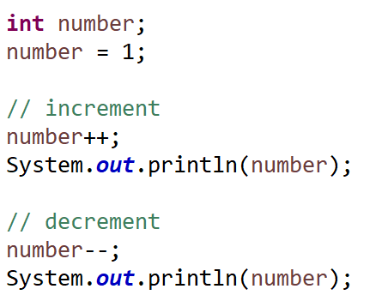
Increment and Decrement Operators
Java provides two unary operators for adding 1 to or subtracting 1 from the value of a numeric variable.
increment operator ++
decrement operator --
For example, using the increment operator ++ like this
num++;
can be used instead of the expression num = num + 1; or num += 1;
Commonly used in loops, especially the for loop
2
1

Slide 4

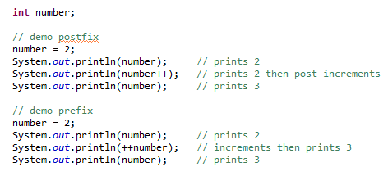
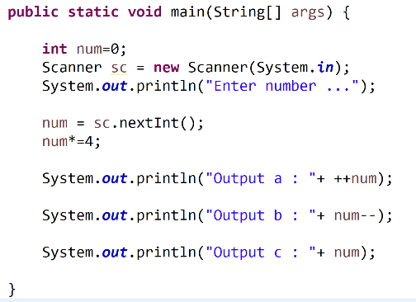
Pre and post fixed
Prefix causes a variable to be incremented and then the new value of the variable is used in the expression it appears.
Postfix causes a variable to be used in the expression it appears and then incremented.
prefix increment | postfix increment
++num | num++
What is the output from the following code if the user enters 4 (followed by the enter key)?
Notes:
Enter number ...
4
Output a : 17
output b : 17
Output c : 16
step-by-step explanation of what the code does when the user enters the number 4:
1. `int num;` declares an integer variable named `num` to store the input number.
2. `num = 0;` initialises the variable `num` to 0, although this initial value is overwritten later.
3. `Scanner scanner = new Scanner(System.in);` creates a Scanner object called `scanner` to read input from the user.
4. `System.out.println("Enter number ...");` displays a message to the user, prompting them to enter a number.
5. `num = scanner.nextInt();` reads an integer entered by the user and stores it in the `num` variable. In this case, the user entered 4.
6. `num *= 4;` multiplies the value of `num` by 4. So, `num` now holds the value 16 (4 multiplied by 4).
7. `System.out.println("Output a : " + ++num);` increments the value of `num` by 1 and then prints it. Since `num` was 16, it becomes 17 after the increment, and "Output a : 17" is printed.
8. `System.out.println("output b : " + num--);` prints the current value of `num` and then decrements it by 1. The current value of `num` is 17 (from the previous step), so "output b : 17" is printed, but after this line, `num` becomes 16.
9. `System.out.println("Outout c : " + num);` prints the current value of `num`, which is 16. So, "Outout c : 16" is printed.

